Slide 1
Mobile Apps Play store Data Analysis
VIKANT KUMAR
21-08-2023

Slide 2
Introduction
This Data Analysis is for getting insights about the mobile apps w.r.t its future business approaches and development of mobile apps. This study has been summarised from the historical data available from the Google Play store from June 2012 till February 2019. It also helps to know the trend involved in the categories of mobile app availability, usability, and users' expectation.

Slide 3
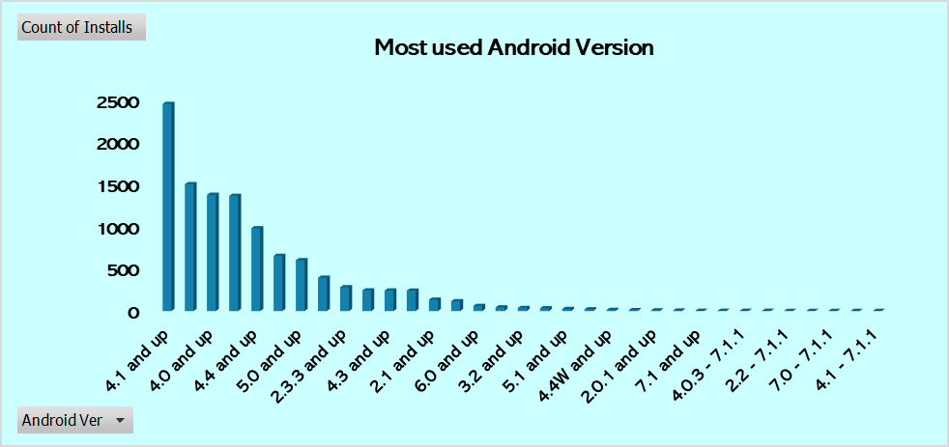
Which is the most used Android version?
The most used android version is 4.1 and up

Slide 4
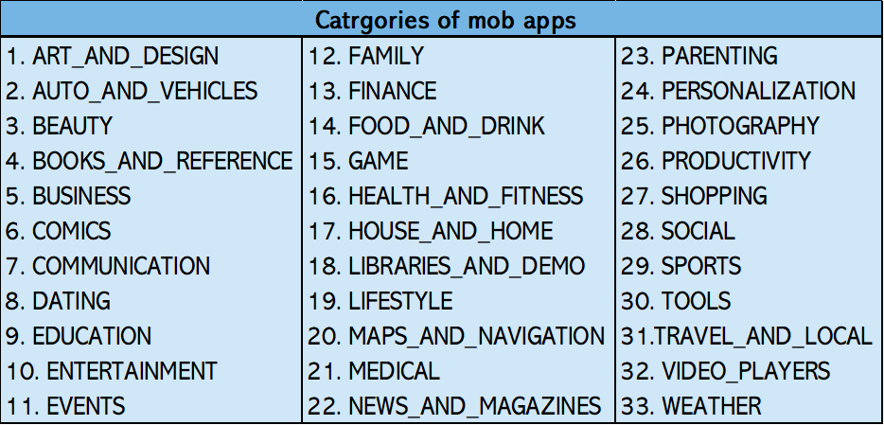
Which all categories of mob apps are existing from this dataset?

Slide 5
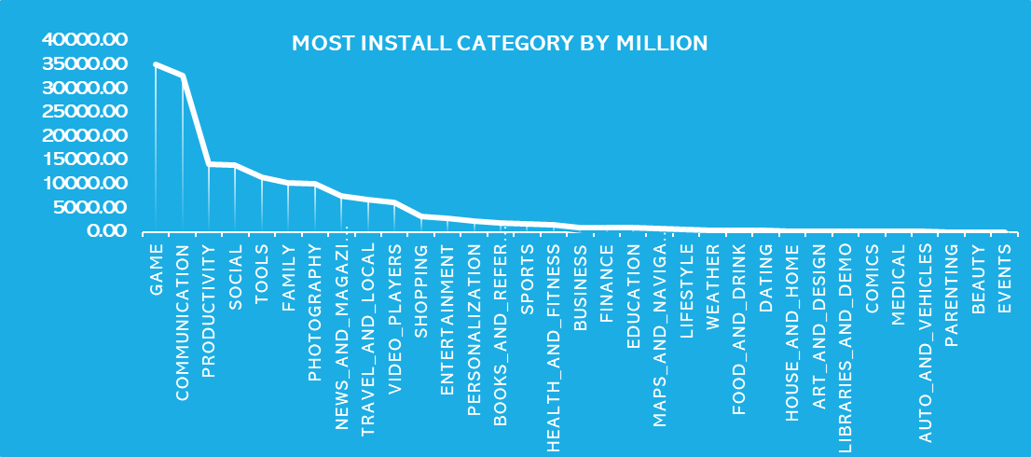
Which is the most installed category of mob app from this dataset?
The most Installed Category of mob app is game by 35086.02 Million

Slide 6
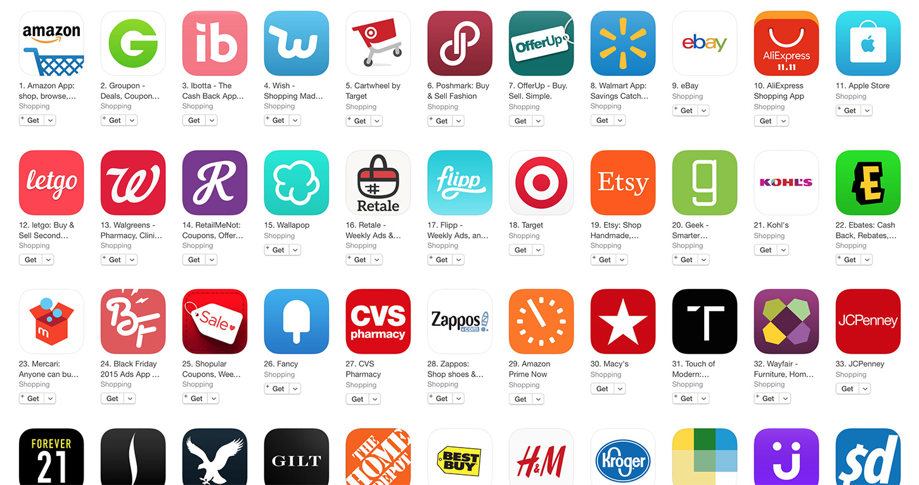
33 CATEGORIES
How many total categories are there?

Slide 7

Which apps have got 5-star ratings ?
271 APPS GOT 5-STAR RATING

Slide 8
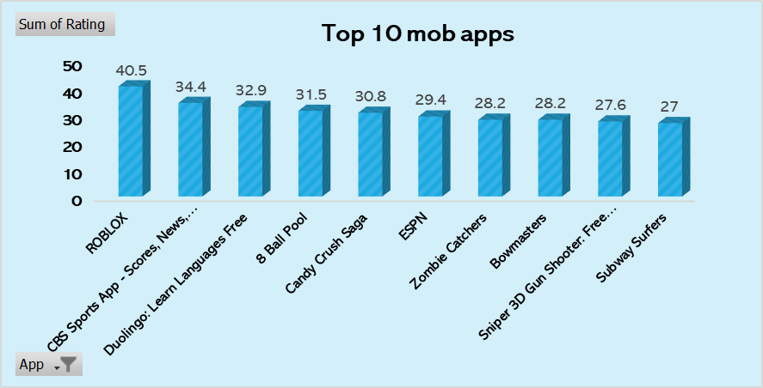
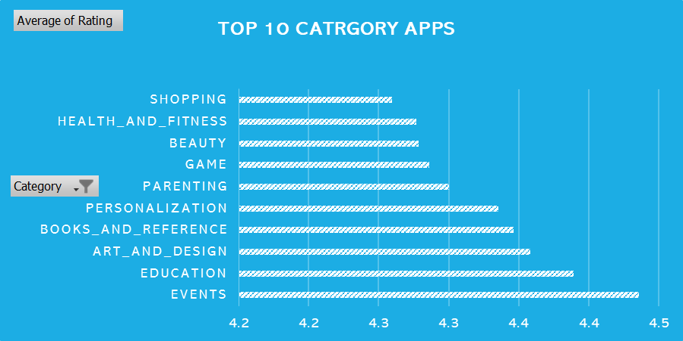
Which are the top 10 mob apps based on ratings?

Slide 9
Conclusion
Our Mobile Apps Play store Data Analysis has shed light on the mobile app landscape's trends and user behaviors. Through historical data exploration, we've identified Android version preferences, popular app categories, and highly rated apps. These insights offer valuable guidance for strategic decision-making and user-focused app development.

Slide 10

THANKS FOR WATCHING

